Slide 1

SOFTWARE ENGINEERING
Week 8
Software Design Engineering II

Slide 2

Object Oriented Design Principles
Unified Modeling Language
Software Design Concepts
Structured Design
Object Oriented Design Principles
User Interface Design
Case Study: SafeHome

Slide 3
Object-Oriented Design Steps
OOD consists of two steps:
Step 1. Complete the class diagram
Determine the formats of the attributes
Assign each method, either to a class or to a client that sends a message to an object of that class
Step 2. Perform the detailed design

Slide 4
The Elevator Problem Case Study
A product is to be installed to control n elevators in a building with m floors. The problem concerns the logic required to move elevators between floors according to the following constraints:
1. Each elevator has a set of m buttons, one for each floor. These illuminate when pressed and cause the elevator to visit the corresponding floor. The illumination is canceled when the corresponding floor is visited by the elevator
2. Each floor, except the first and the top floor, has two buttons, one to request an up-elevator, one to request a down-elevator. These buttons illuminate when pressed. The illumination is canceled when an elevator visits the floor, then moves in the desired direction
3. If an elevator has no requests, it remains at its current floor with its doors closed

Slide 5
The Elevator Problem Case Study
There are two sets of buttons
Elevator buttons
In each elevator, one for each floor
Floor buttons
Two on each floor, one for up-elevator, one for down-elevator

Slide 6
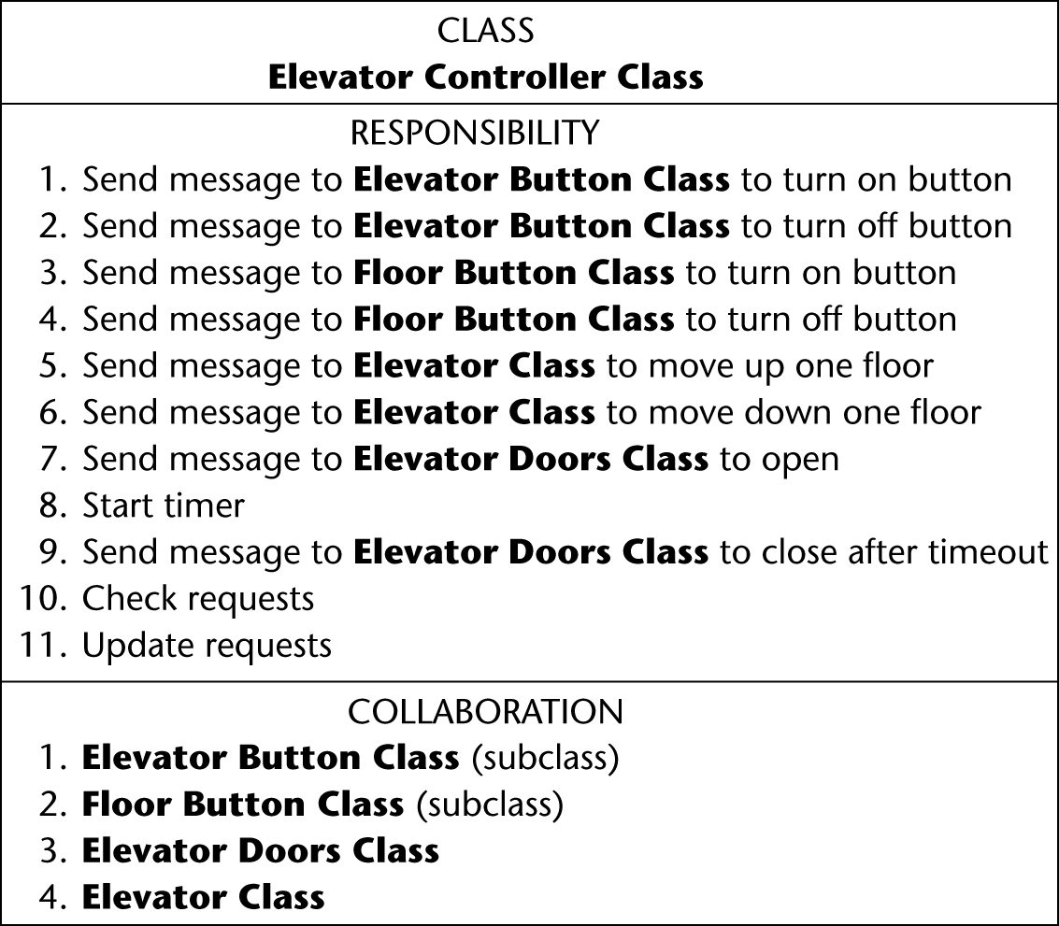
OOD: Elevator Problem Case Study
Step 1. Complete the class diagram
Consider the CRC card
Figure 13.9

Slide 7
OOD: Elevator Problem Case Study
Responsibilities
8. Start timer
10. Check requests, and
11. Update requests
are assigned to the elevator controller
Because they are carried out by the elevator controller

Slide 8
OOD: Elevator Problem Case Study
The remaining eight responsibilities have the form
“Send a message to another class to tell it do something”
These should be assigned to that other class
Responsibility-driven design
Safety considerations
Methods open doors, close doors are assigned to class Elevator Doors Class
Methods turn off button, turn on button are assigned to classes Floor Button Class and Elevator Problem Class

Slide 9
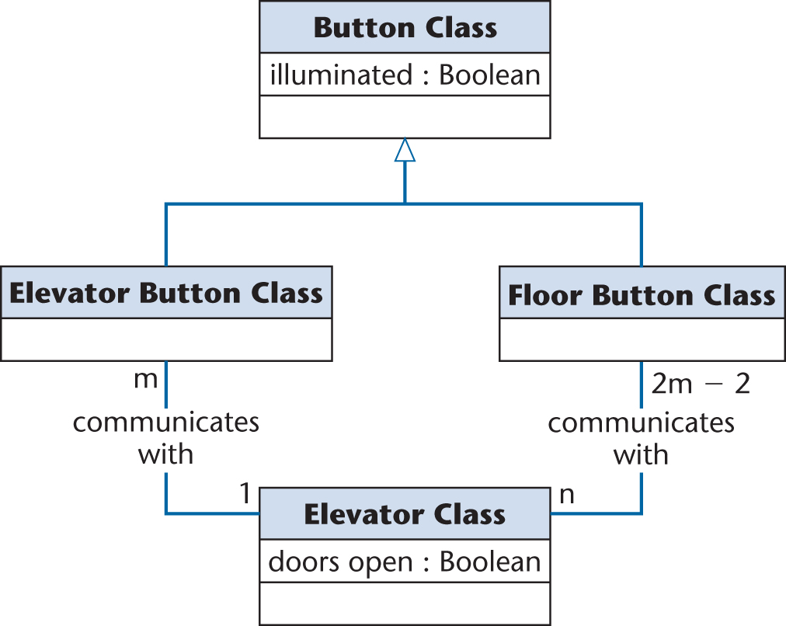
First Iteration of Class Diagram
Problem
Buttons do not communicate directly with elevators
We need an additional class: Elevator Controller Class
Figure 13.5

Slide 10
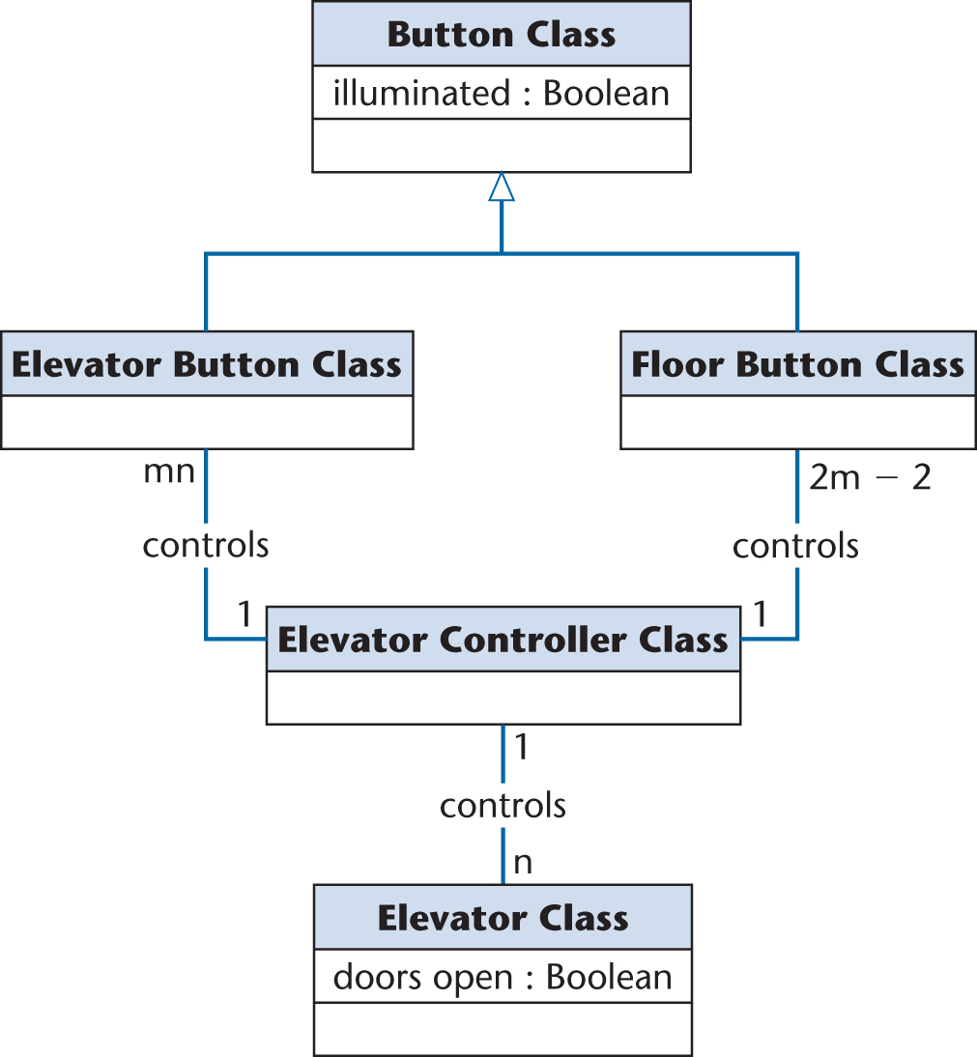
Second Iteration of Class Diagram
All relationships are now 1-to-n
This makes design and implementation easier
Figure 13.6

Slide 11
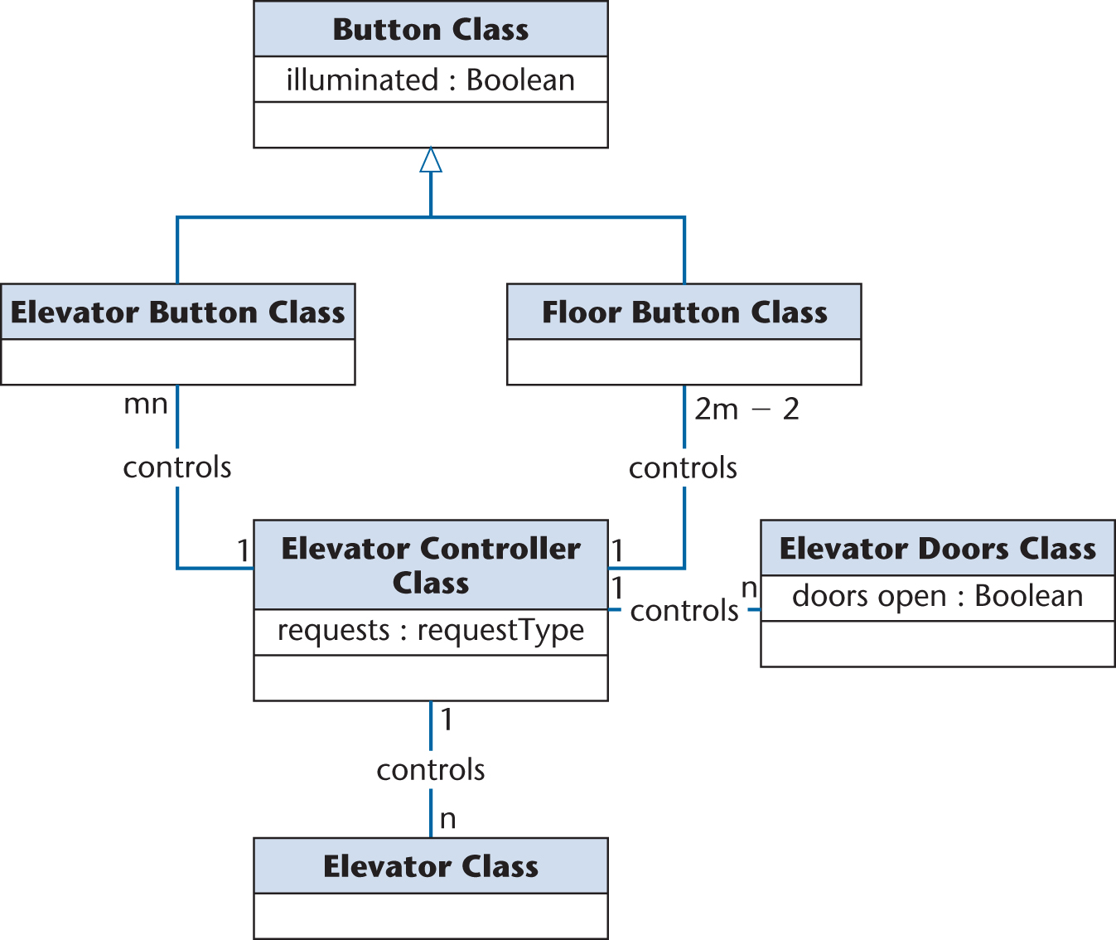
Third Iteration of Class Diagram
Figure 13.10

Slide 12
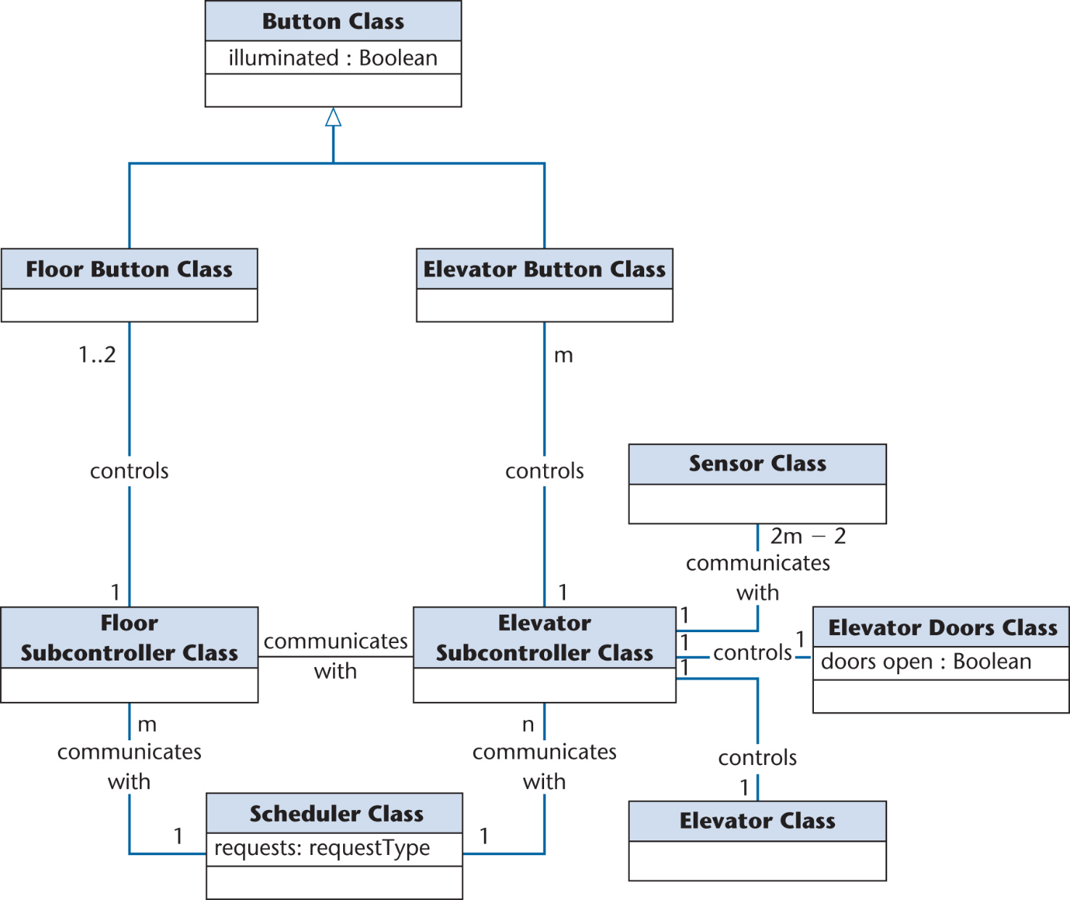
Fourth Iteration of Class Diagram
Figure 13.12

Slide 13
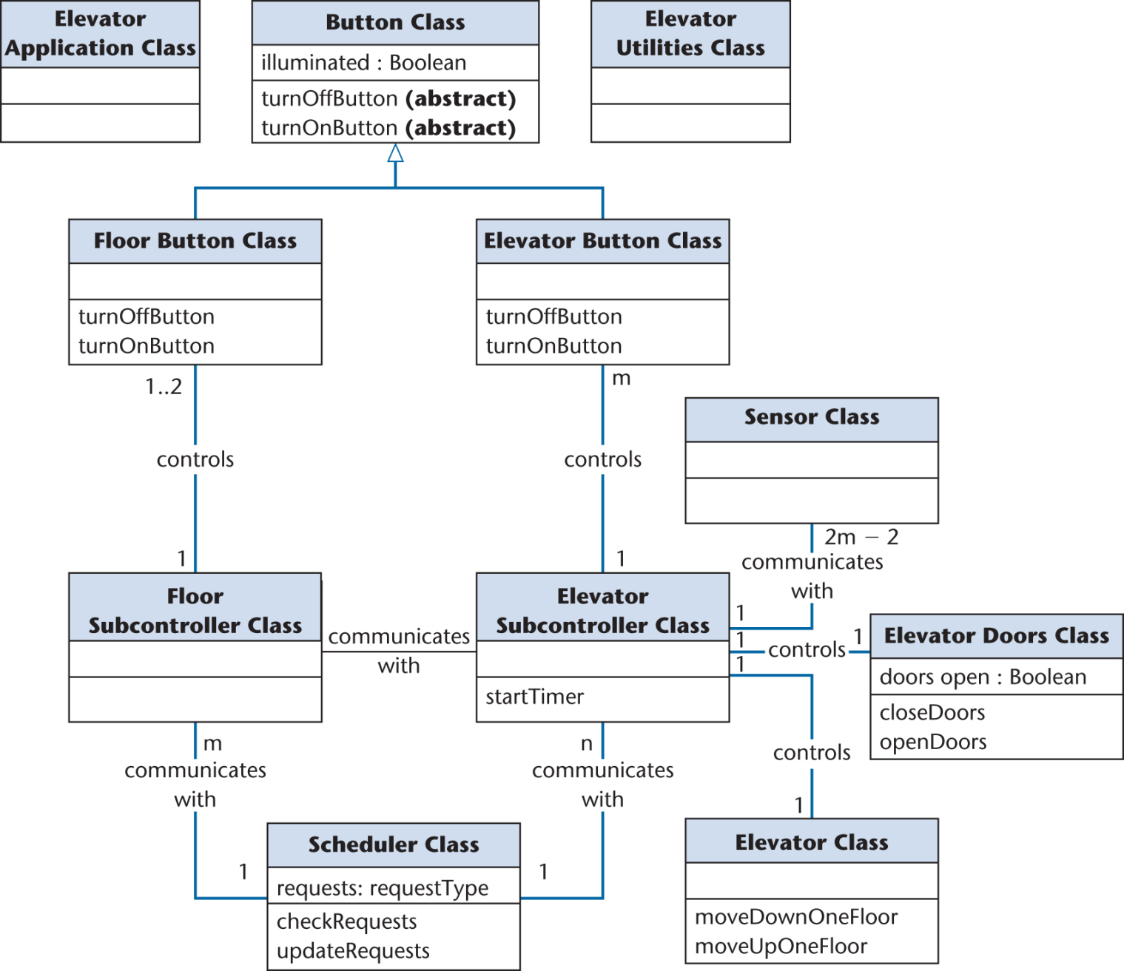
Detailed Class Diagram: Elevator Problem
Figure 14.11

Slide 14
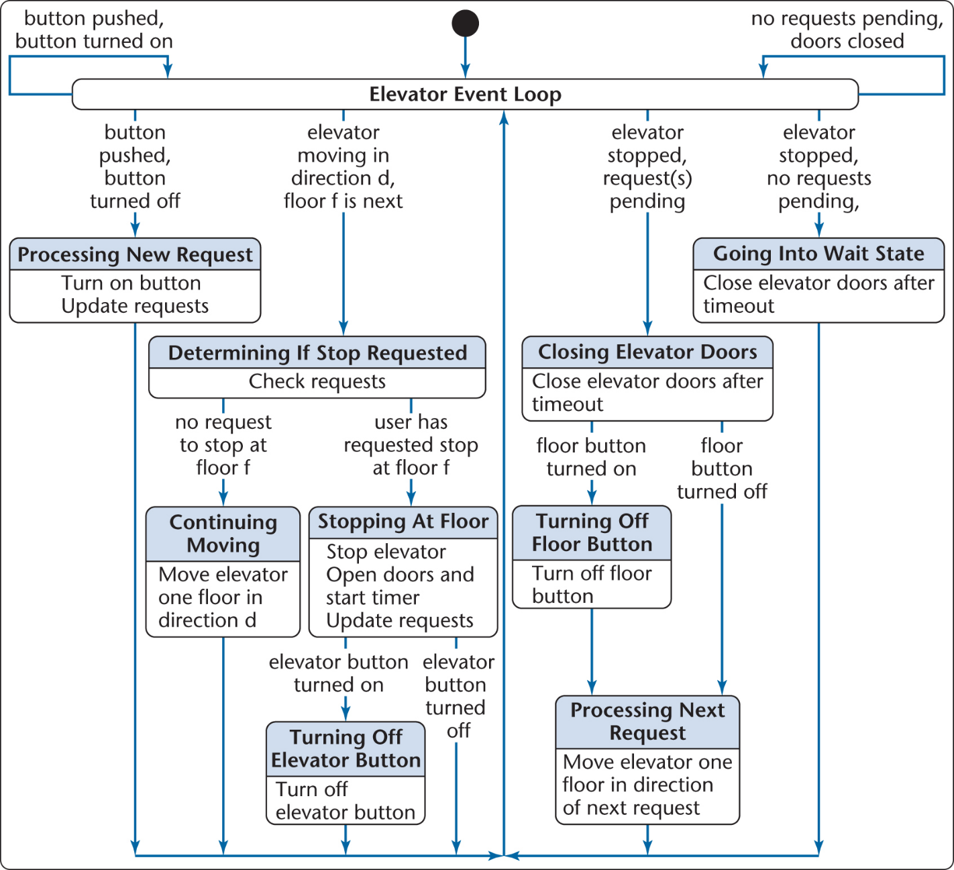
Dynamic Modeling: The Elevator Problem Case Study
Produce a UML statechart
State, event, and predicate are distributed over the statechart
Figure 13.7

Slide 15
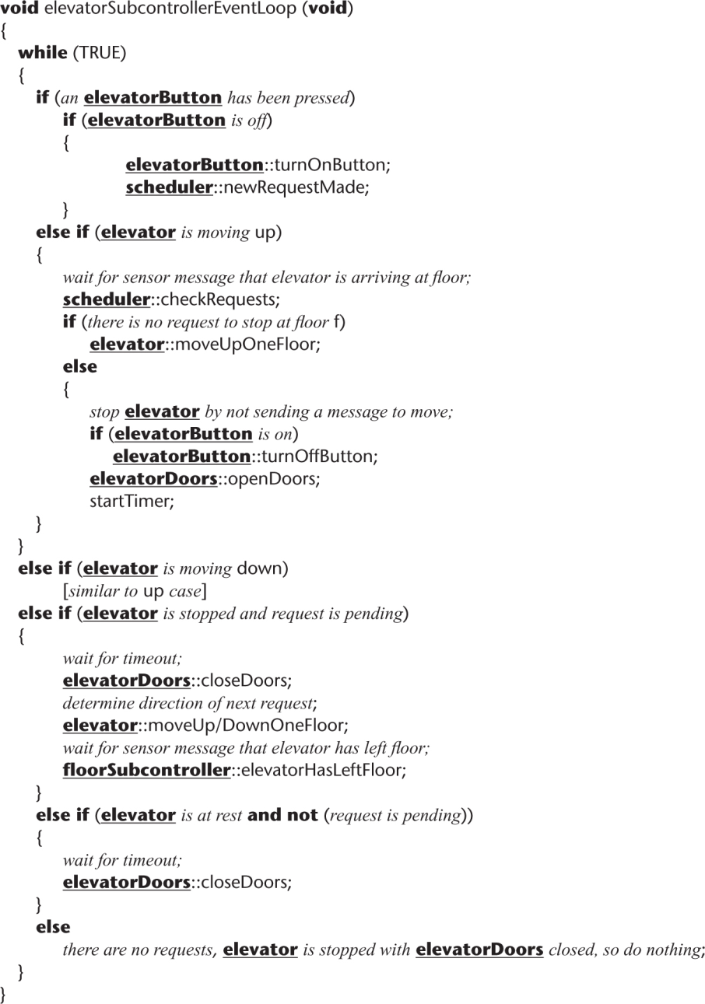
Detailed Design: Elevator Problem
Detailed design of elevatorEventLoop is constructed from the statechart
Figure 14.12

Slide 16
Design Principles
Software modules should be in a hierarchical organization.
Software should be modular, that is, the software should be logically partitioned into elements that perform specific functions.
Should contain both data abstraction and procedural abstraction.
Should lead to interfaces that reduce the complexity of connections between modules (low coupling).
Must be an understandable guide for coders, testers and maintainers.
Should exhibit uniformity and integration.
16

Slide 17
Design Strategies
Stepwise refinement:
It is a top-down design strategy.
A higher level abstraction is refined to a lower level abstraction with more details in each step.
Several steps are taken.
Top-down design:
First design is the very high level structure of the system.
Then gradually work down to detailed decisions about low-level constructs.
Finally arrive at detailed individual algorithms that will be used.
Divide and conquer:
Trying to deal with something big all at once is normally much harder than dealing with a series of smaller things .
Separate people can work on each part.
Each individual component is smaller, and therefore easier to understand.
17

Slide 18
Cohesion
Cohesion is a measure of dependencies within a module.
If a module contains many closely related functions its cohesion is high.
The designer should aim high cohesion.
Module is understandable as a meaningful unit
Functions of a module are closely related to one another
This makes the system as a whole easier to understand and change
Functional cohesion (best)
Informational cohesion (desirable)
Communicational cohesion
Procedural cohesion
Temporal cohesion
Logical cohesion (should be avoided)
Coincidental cohesion (worst)
18
Notes:
Functional cohesion:
This is achieved when all the code that computes a particular result is kept together - and everything else is kept out
i.e. when a module only performs a single computation, and returns a result, without having side-effects.
Examples of high cohesion
sin() , getEmployeeName(),calcLoanPayment(), getIconLocation()
Examples of low cohesion
getEmployeeNameAndChangeHerSalary()
Communicational cohesion: All the modules that access or manipulate certain data are kept together (e.g. in the same class) - and everything else is kept out

Slide 19
Coupling
Coupling is a measure of the dependencies between two modules.
If two modules are strongly coupled, it is hard to modify one without modifying the other.
The designer should aim low coupling.
Modules have low interactions with others
Understandable separately
Data coupling
Stamp coupling
Control coupling
Common coupling
Content coupling
19
Notes:
Coupling occurs when there are interdependencies between one module and another (complement of cohesion)
Content coupling is the worst: When one component surreptitiously modifies data that is internal to another component.

Slide 20
Example of content coupling
public class Line
{
private Point start, end;
...
public Point getStart() { return start; }
public Point getEnd() { return end; }
}
public class Arch
{
private Line baseline;
...
void move(int newX, int newY){
Point theEnd = baseline.getEnd();
theEnd.setX(newX);
theEnd.setY(newY);
}
}
public class Point
{
private int x, y;
...
public void setX(int x){ this.x = x; }
public void setY(int y){ this.y = y; }
}

Slide 21
One solution (other solutions exist)
public class Line
{
private Point start, end;
...
public Point getStart() { return start; }
public Point getEnd() { return end; }
public void moveEnd(int x, int y) {
end = new Point(x, y);
}
}
public class Arch
{
private Line baseline;
...
void move(int newX, int newY){
baseLine.moveEnd(newX, newY);
}
}
public class Point
{
private int x, y;
...
}
© Lethbridge/Laganière 2005
Chapter 9: Architecting and designing software
21

Slide 22
Coupling
High coupling
Low coupling
22

Slide 23
User Interface Design
Unified Modeling Language
Software Design Concepts
Structured Design
Object Oriented Design Principles
User Interface Design
Case Study: SafeHome

Slide 24
Aspects of usability
24
Usability: The system should allow the user to learn and to use the basic capabilities easily.
Usability can be divided into separate aspects:
Learnability
The speed with which a new user can become proficient with the system.
Efficiency of use
How fast an expert user can do their work.
Error handling
The extent to which it prevents the user from making errors, detects errors, and helps to correct errors.
Acceptability
The extent to which users like the system.
Notes:
24

Slide 25
Terminology of Graphical User Interface (GUI)
Dialog: A specific window with which a user can interact, but which is not the main UI window.
Control or Widget: Specific components of a user interface.
Affordance: The set of operations that the user can do at any given point in time.
State: At any stage in the dialog, the system is displaying certain information in certain widgets, and has a certain affordance.
Mode: A situation in which the UI restricts what the user can do.
Modal dialog: A dialog in which the system is in a very restrictive mode.
Feedback: The response from the system whenever the user does something, is called feedback.
Encoding techniques. Ways of encoding information so as to communicate it to the user.
25
Notes:
25

Slide 26
User Interface Design Principles
Principle | Description
User familiarity | Use terms and concepts which are drawn from the experienced users.
Consistency | Be consistent in that, similar operations should be activated in the same way.
Recoverability | Include mechanisms to allow users to recover from errors.
User guidance | Provide meaningful feedback when errors occur and provide context-sensitive user help facilities.
User diversity | Provide appropriate interaction facilities for different types of users (such as clerk or manager).
26

Slide 27
Usability Principles (1)
1. Base the User Interface designs on users’ tasks.
Perform use case analysis to structure the UI.
2. Ensure that the sequences of actions to achieve a task are as simple as possible.
Reduce the amount of manipulation the user has to do.
Ensure the user does not have to navigate anywhere to do subsequent steps of a task.
3. Ensure that the user always knows what he should do next.
Ensure that the user can see what commands are available.
Make the most important commands stand out.
27
Notes:
27

Slide 28
Usability Principles (2)
4. Provide good feedback including effective error messages.
Inform users of the progress of operations and of their location as they navigate.
When something goes wrong, explain the situation in adequate detail and help the user to resolve the problem.
5. Ensure that the user can always get out, go back or undo an action.
Ensure that all operations can be undone.
Ensure it is easy to navigate back to where the user came from.
6. Ensure that response time is adequate.
Keep response time less than a second for most operations.
Warn users of longer delays and inform them of progress.
28
Notes:
28

Slide 29
Usability Principles (3)
29
7. Use understandable encoding techniques.
Choose encoding techniques with care.
Use labels to ensure all encoding techniques are fully understood by users.
8. Ensure that the UI’s appearance is uncluttered.
Avoid displaying too much information.
Organize the information effectively.
Use consistent language and meaningful keywords
Avoid abbreviations
Make text readable, use both upper and lower case
Use colors and graphics effectively
Notes:
29

Slide 30
Usability Principles (4)
9. Robustness.
Minimize keystroke and mouse travel distance
Provide defaults for missing data (e.g. current date)
Automatically correct the obvious errors
10. Provide all necessary help.
Integrate help with the application.
Ensure that the help is accurate.
11. Be consistent and uniform.
Use similar layouts and graphic designs throughout your application.
Follow look-and-feel standards.
30
Notes:
30

Slide 31
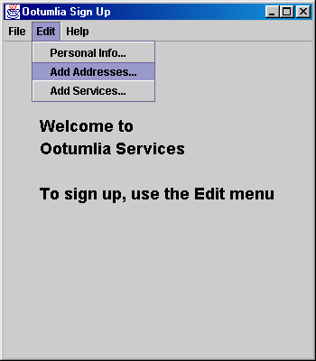
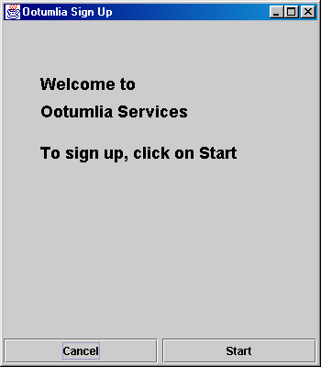
Example: Welcome screen
Wrong
Correct
31

Slide 32
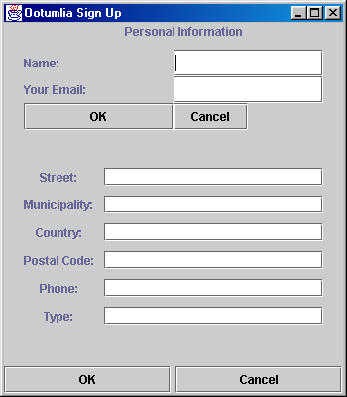
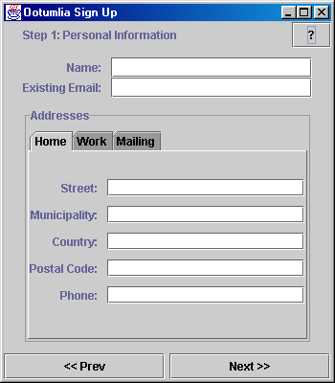
Example: Personal information screen
Wrong
Correct
32

Slide 33
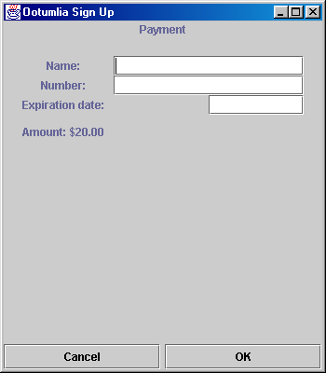
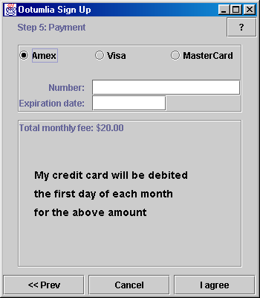
Example: Payment screen
Wrong
Correct
33

Slide 34
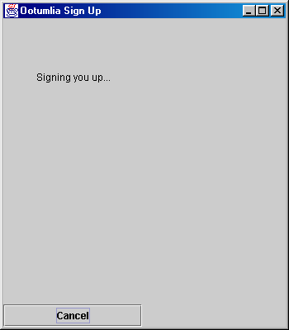
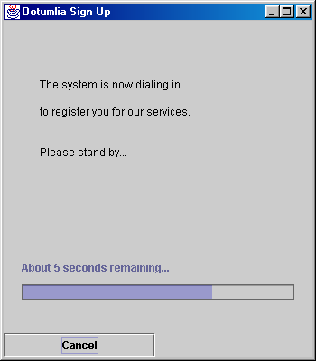
Example: Sign up screen
Wrong
Correct
34

Slide 35
User Interface Patterns
Many standard patterns are available for
Page layout
Page elements
Forms and input
Tables
Direct data manipulation
Navigation
Searching
35

Slide 36
Example: Web page layout
36

Slide 37
Case Study: SafeHome
Unified Modeling Language
Software Design Concepts
Structured Design
Object Oriented Design Principles
User Interface Design
Case Study: SafeHome

Slide 38
SafeHome Product Definition
The product, called SafeHome, is a microprocessor based home security system (embedded) that would protect against burglary, fire, flooding and others.
It will be configured by the homeowner.
It will use appropriate sensors to detect each emergency situation.
It will automatically make a telephone call to a monitoring agency (police, fire brigade) when a situation is detected.
38

Slide 39
Statement of Software Scope (1)
SafeHome software enables the homeowner to configure the security system when installed, monitors all sensors connected to the security system, and interacts with the homeowner through a keypad and function keys contained in the SafeHome control panel.
During installation, the SafeHome control panel is used to "program" and configure the system. Each sensor is assigned a number and type, a master password for arming and disarming the system, and telephone numbers are input for dialing when a sensor event occurs.
Data objects: Underlined nouns
Processes: Italic verbs
39

Slide 40
Statement of Software Scope (2)
When a sensor event is recognized, the software invokes an audible alarm attached to the system. After a delay time, that is specified by the homeowner during the system configuration activities, the software dials a telephone number of a monitoring service agency, provides information about the location, reporting the nature of the event that has been detected. The telephone number will be redialed every 20 seconds until telephone connection is obtained.
All interaction with SafeHome is managed by a user-interaction subsystem that reads input provided through the keypad and function keys, displays prompting messages and system status on the LCD display. Keyboard interactions takes the following form: (continues...)
40

Slide 41
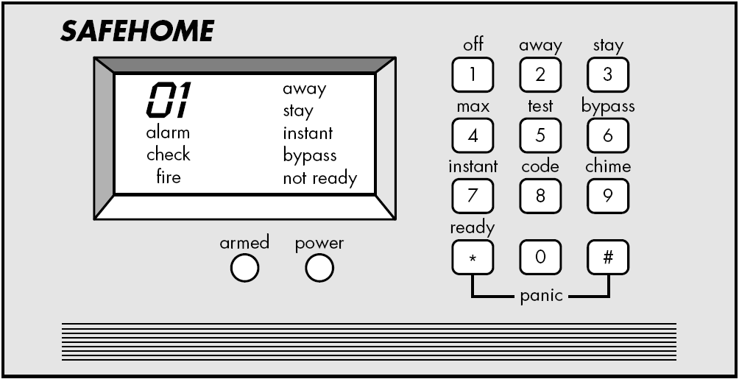
SafeHome Control Panel
41

Slide 42
SafeHome “Alarm sub-system”
42

Slide 43
Alarm sub-system descriptions
Sub-system | Description
Movement sensors | Detects movement in the rooms monitored by the system
Door sensors | Detects door opening in the external doors of the building
Alarm controller | Controls the operation of the system
Siren | Emits an audible warning when an intruder is suspected
Voice synthesizer | Synthesizes a voice message giving the location of the suspected intruder
Telephone caller | Makes external calls to notify security, the police, etc.
43

Slide 44
Customer Requirements
Objects:
Smoke detectors
Door and window sensors
Motion detectors
An audio-alarm
A control panel with a display screen
Telephone numbers to call
Services:
Setting the alarm
Monitoring the sensors
Dialing the phone
Programming the control panel
Reading the display
Constraints:
Must be user friendly
Must interface directly to a standard phone line
Performance Criteria:
A sensor event should be recognized within one second
An event priority scheme should be implemeted
44

Slide 45
SafeHome Functions
SafeHome Software
Configure system Monitor Sensors Interact with user
Poll for Activate
sensor event alarm functions
Read Identify Activate/ Activate Dial
sensor status event type deactivate audible phone
sensor alarm
45

Slide 46
SafeHome Entity Relationship Diagram
USER INFO
SENSORS
ALARMS
address
password
sensor ID
sensor name
sensor type (smoke, thief, etc)
sensor location
sensor ID
alarm type
time-out duration
phone number
agency name
message (sound or text)
46

Slide 47
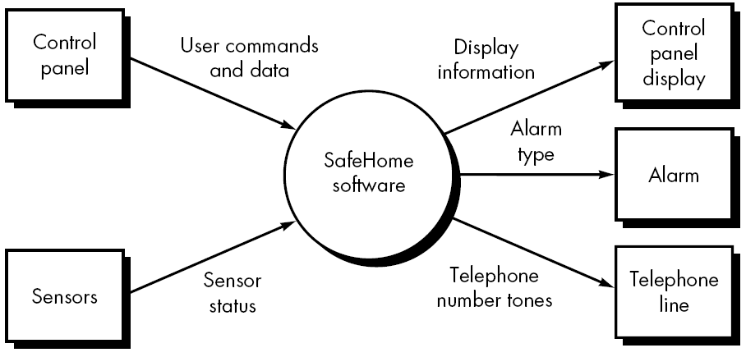
Level-0 DFD
47

Slide 48
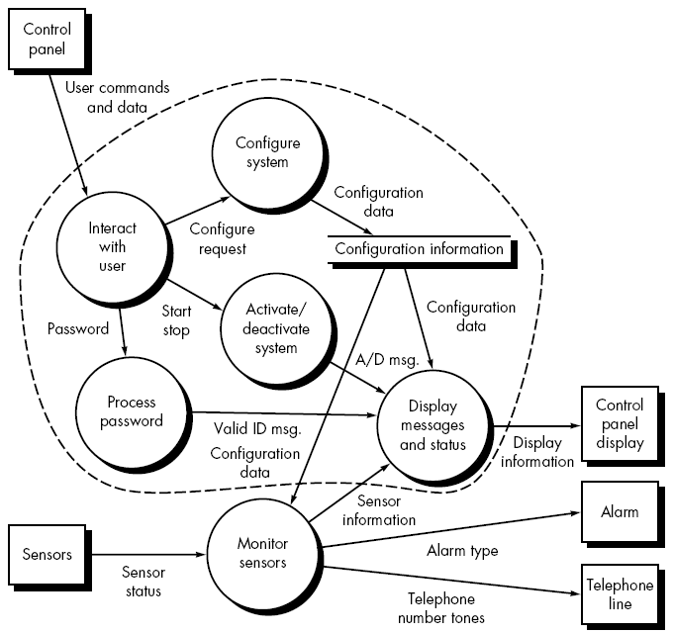
Level-1 DFD
48

Slide 49
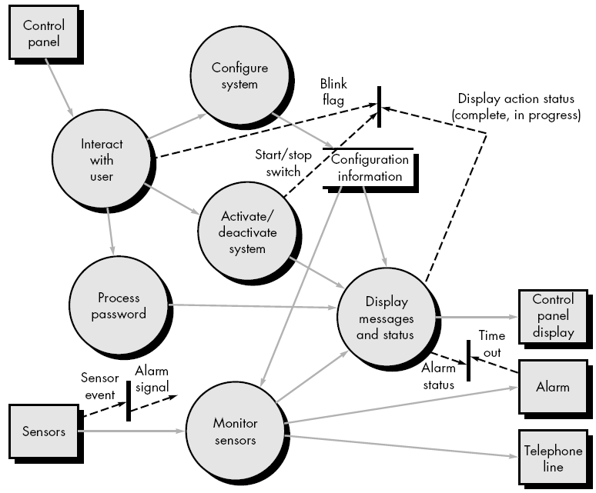
Level-1 CFD
(CFD contains events)
49

Slide 50
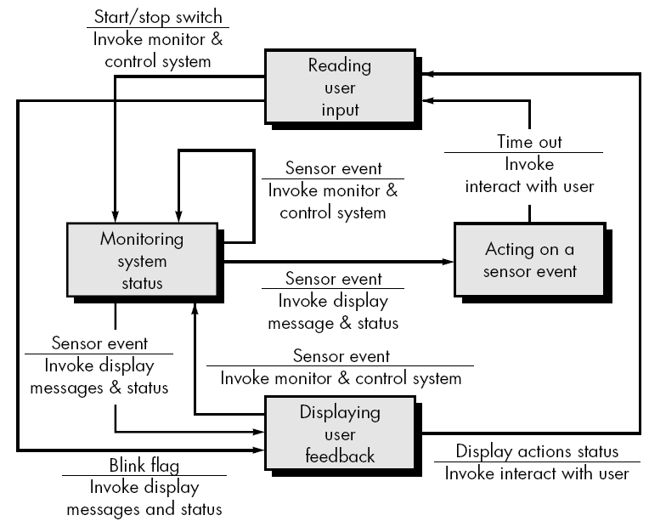
SafeHome State Transition Diagram
4
1
3
2
50

Slide 51
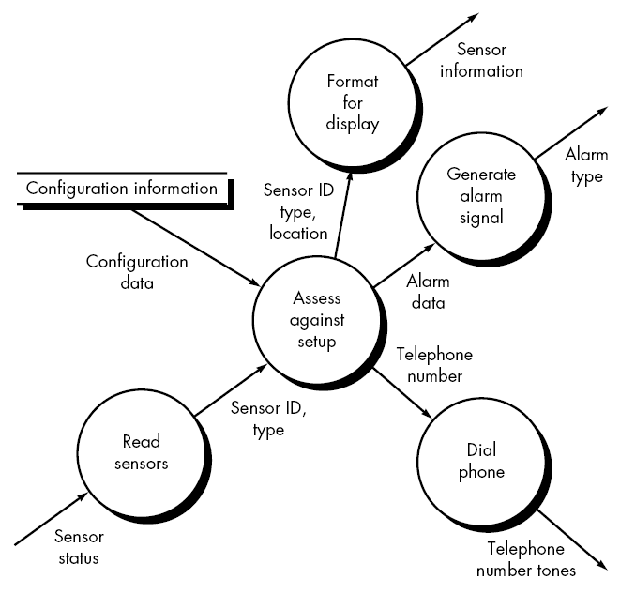
Level-2 DFD (“Monitor sensors”)
51

Slide 52
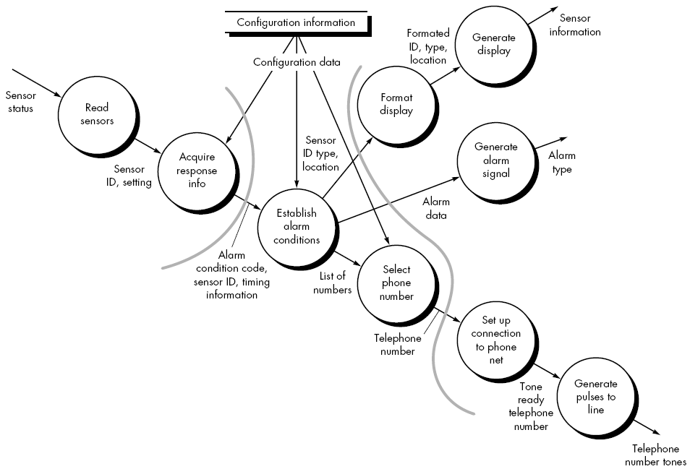
Level-3 DFD (“Monitor sensors”)
52

Slide 53
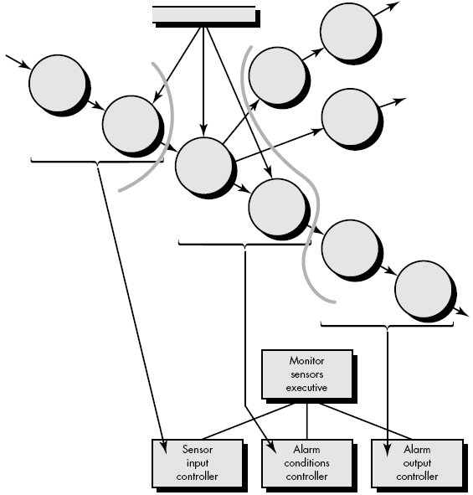
Program Structure: First factoring (“Monitor sensors”)
53

Slide 54
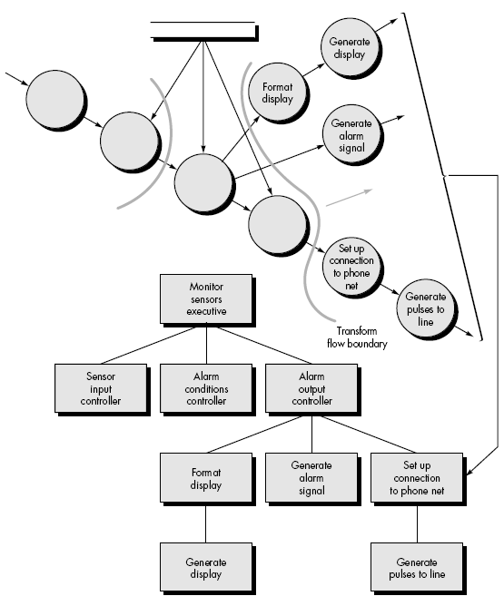
Program Structure: Second factoring
54

Slide 55
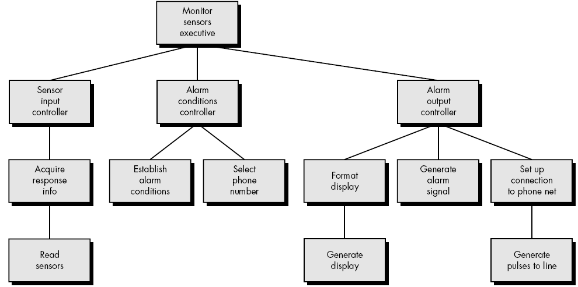
Program Structure: (“Monitor sensors”)
55

Slide 56
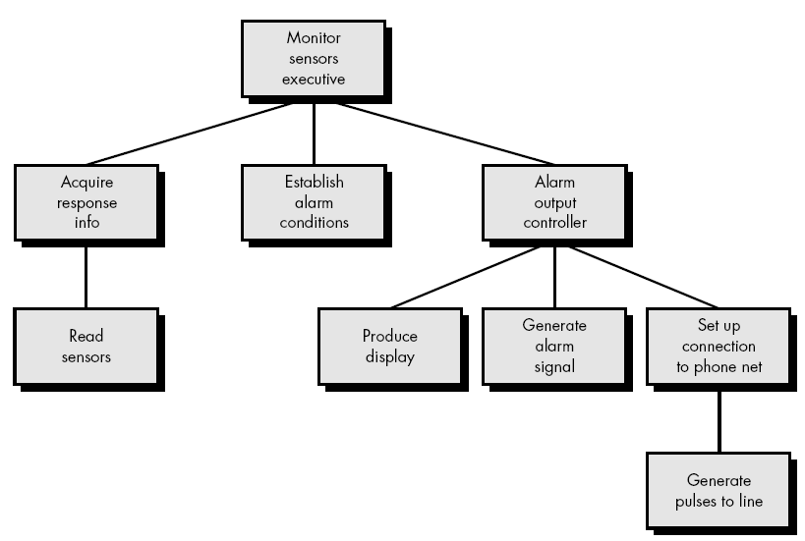
Refined Program Structure: (“Monitor sensors”)
56

Slide 57
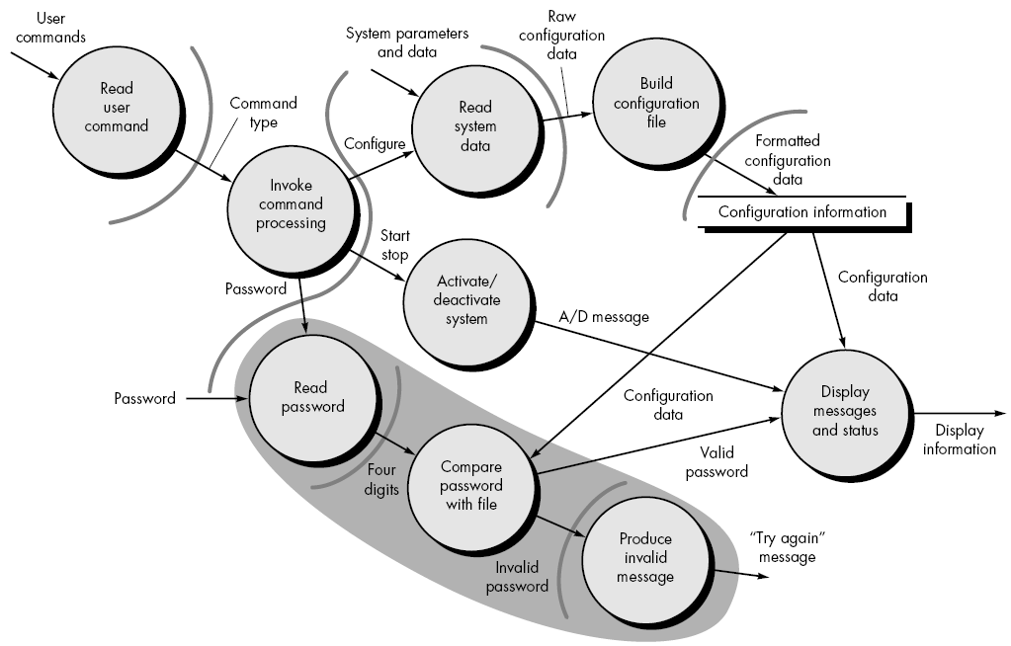
Level-2 DFD (user interaction subsystem)
57

Slide 58
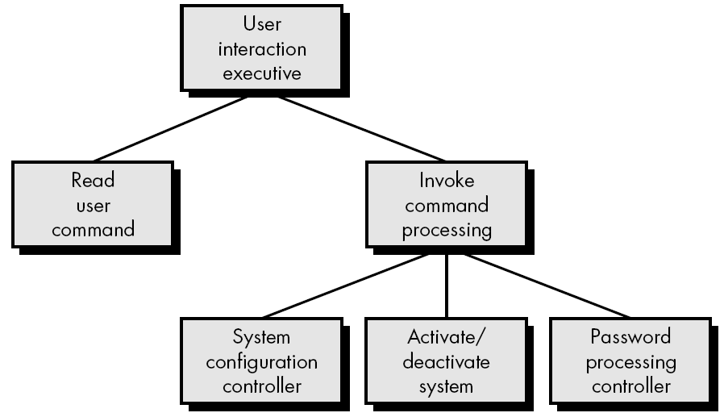
Program Structure: First factoring (user interaction subsystem)
58

Slide 59
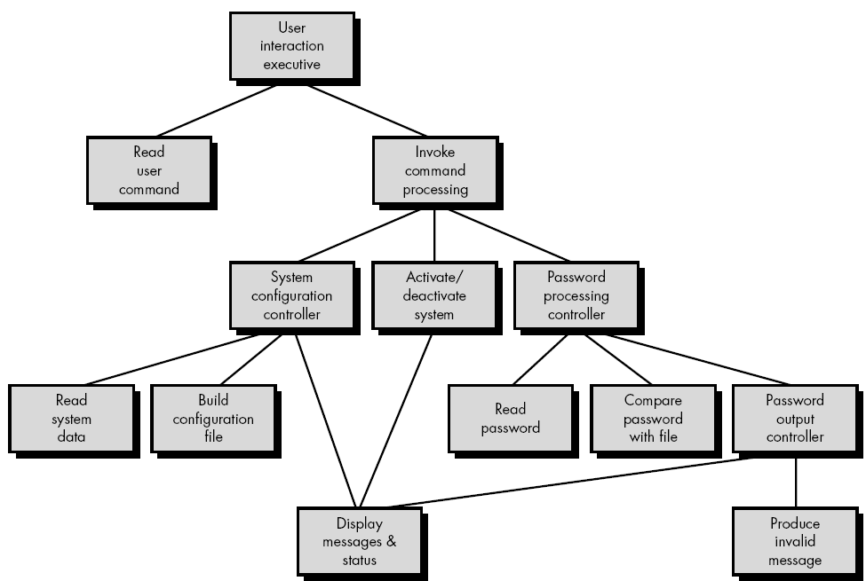
Program Structure:(user interaction subsystem)
59

Slide 60
Wrap-up
This week we present
Software Design Concepts
Objectives of good software design: Modularity and Reusability
Structured and Object Oriented Design
When and how to apply each approach
How to add functions to classes and distingusih between domain and software classes
How to identify modules in data flow diagrams
Design Principles
Coupling and cohesion at various different levels.
User Interface Design

Slide 61
Next Week
We will be covering Good Implementation Principles and Software Testing!!!

